Slide 1
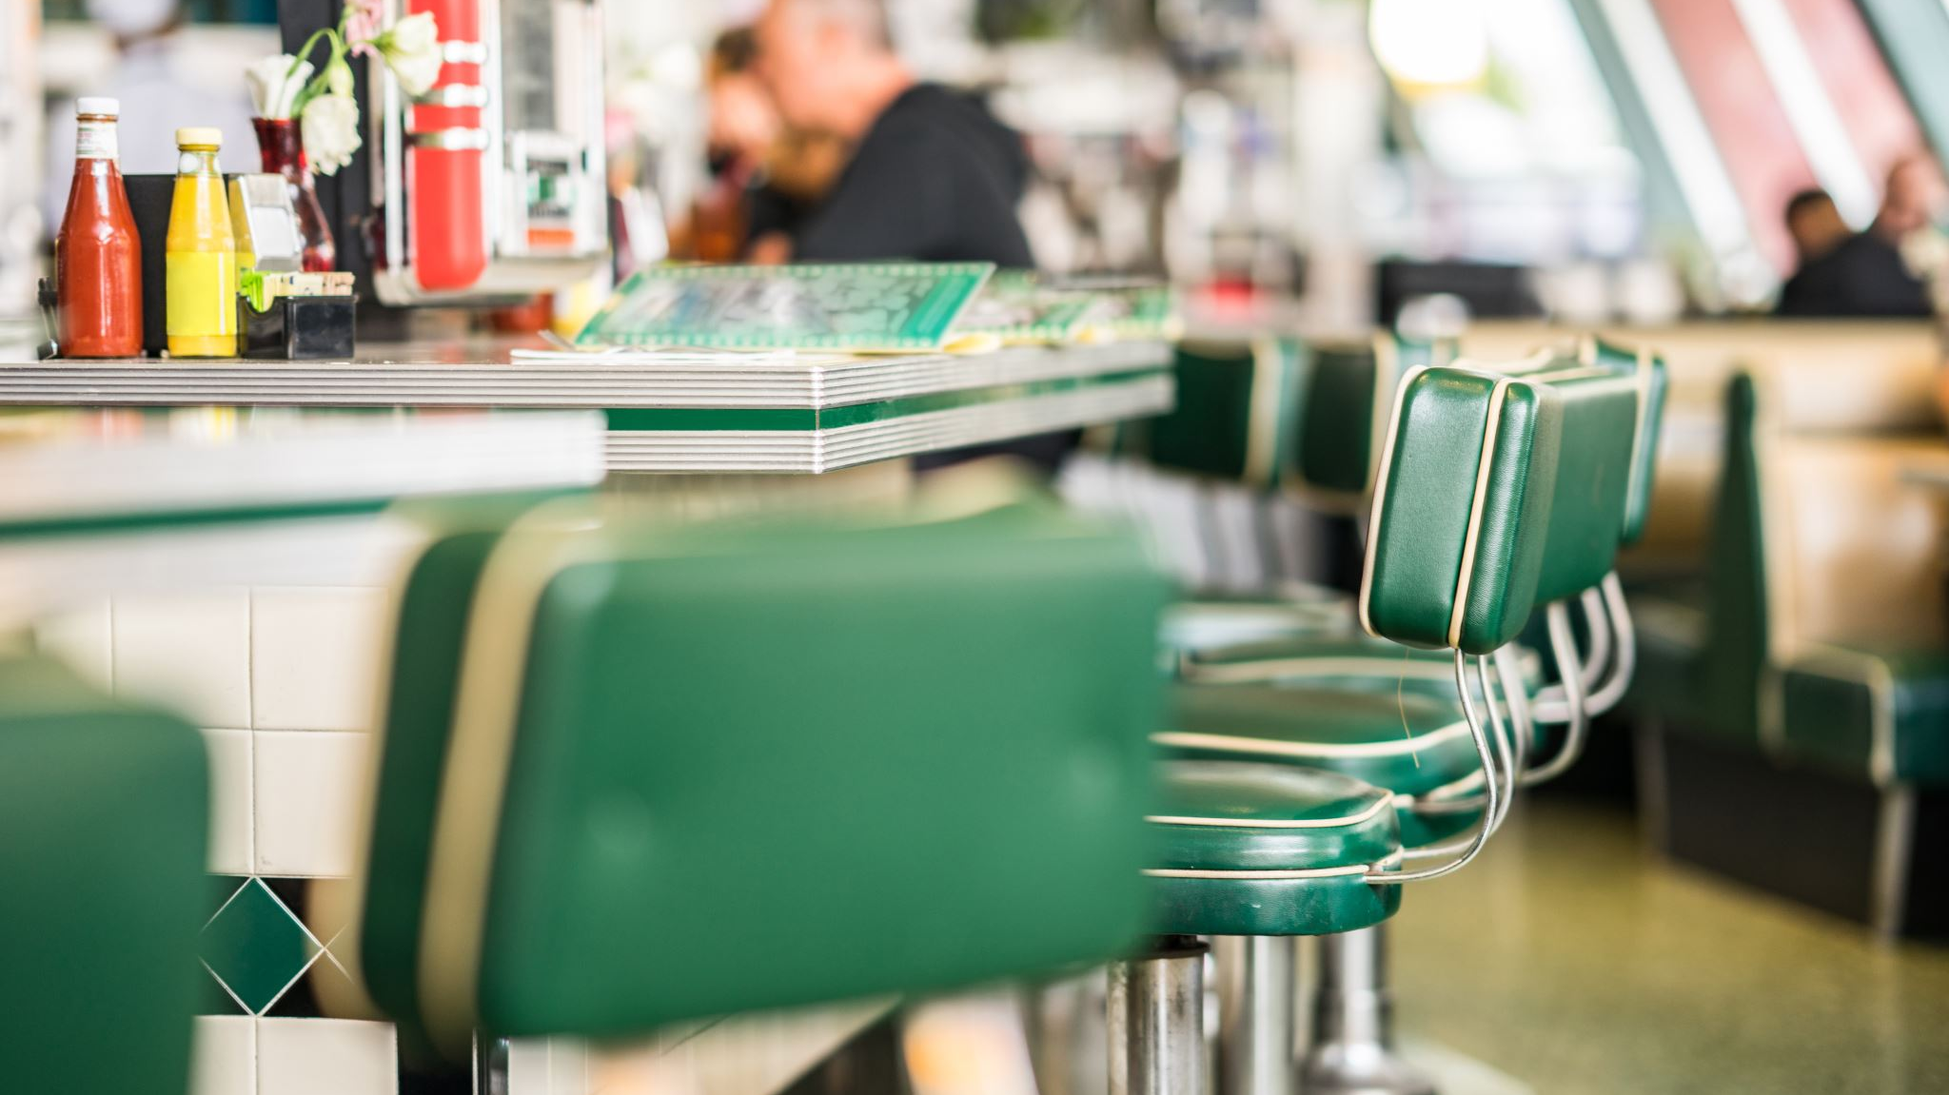
Restaurant/CAFÉ review
NLP / Sentiment analysis for hardware societe, melbourne
MINI PROJECT 3, Matt HAcket

Slide 2

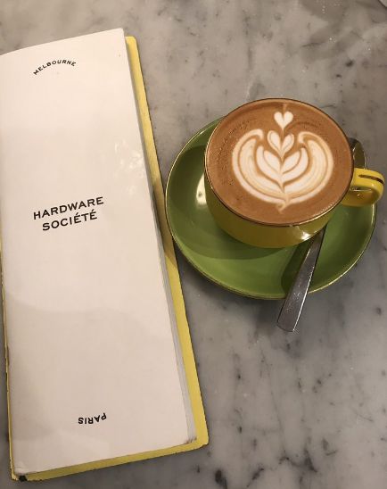
AGENDA
Background
Business Question
Data Pipeline
Data Information
Data Visualisation
Discussion
Conclusion

Slide 3
BACKGROUND
Melbourne has a vibrant café culture, tucked within alleyways in the city
“the city's prevalent cafe culture, alfresco dining, rooftop bars and diverse food culture make it a popular spot for gastronomical tourism”
Melbourne cafes on Yelp – Hardware Societe is #2 in both number of reviews and highest reviews

Slide 4
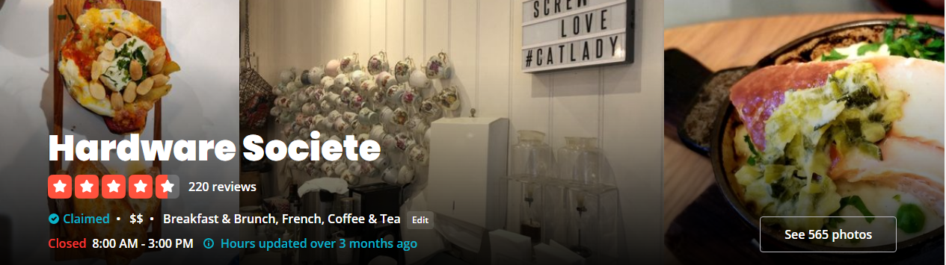
BUSINESS QUESTION?
Imagine you all have ownership stakes in:
Hardware Societe, Melbourne
How are we doing?
Are we looking at all possible avenues to improve?
Can we glean any information on the business from how the café is reviewed on Yelp?

Slide 5
DATA PIPELINE
Business Question
Data acquisition - yelp
Processing data
  EDA/Visualisation
  Pre-processing in preparation for:
Modelling - NLP/Sentiment Analysis
  NLP: NLTK; Sentiment Analysis: TextBlob

Slide 6

DATA information
Web scraping:
  Yelp – 220 reviews, 22 pages of reviews
Data:
  5 Features – Name, Date, Location, Star Rating, Review
    Feature engineering to 13 features – review length, characters, word length etc.
  210 final reviews

Slide 7
DATA information
210 Reviews:
  5 stars = 111
  4 stars = 72
  3 stars = 13
  2 stars = 8
  1 star = 6
210 Reviews:
  107 words long
  Avg word – 4.56 letters
Locations:
  Aus = 110
  US = 72
  Other = 28
Stars by loc:
  Mean: 4.30
  Aus: 4.12
  US: 4.6

Slide 8
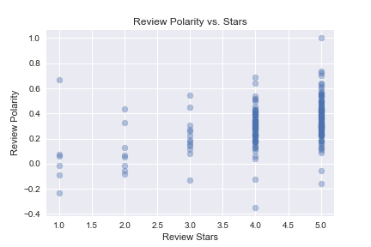
DATA VISUALISATION
Polarity:
  Min: -0.35
  Max: 1.00
  Mean: 0.311
Subjectivity:
  Min: 0.15
  Max: 1.00
  Mean: 0.58

Slide 9
RESULTS - modelling
Target = supervised classification of star class
    Changed stars from 1-5 to negative (1-2), neutral (3 stars), positive (4-5 stars)
Feature = vectorized clean reviews – removed punctuation, stop words, lemmatized
Models:
  Multinomial Naïve Bayes
  Random Forest Classifier
  Decision Tree Classifier
  Support Vector Classifier
  Kneighbors Classifier
  XGBoost Classifier
  Multilayer Perceptron Classifier

Slide 10
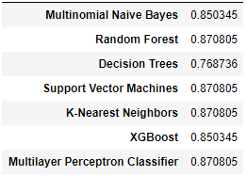
RESULTS - modelling
Using 5 Fold CV:
Best Performing Models:
Random Forest / SVM / KNN / MLP
Multinomial NB / XGBoost
Decision Trees

Slide 11
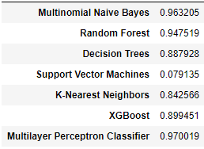
RESULTS - modelling
Best Performing ROC/AUC SCore:
MLP
Multinomial NB
Random Forest
XGBoost
Decision Trees
KNN
SVM (8%)

Slide 12
DISCUSSION
Best performing models were:
  Random Forest / SVM / KNN / MLP
Best model with ROC-AUC:
  MLP
The Multilayer Perceptron Classifier can model with 87% accuracy, the reviews that customers are making on Yelp correspond with their star reviews

Slide 13
DISCUSSION
Very unbalanced data set – 111 5 star reviews; 6 1 star
  Not much to be done about that – if we own a certain business, we can’t choose what the reviews say about our business
Slightly higher ratings from Americans – could be as a function of being on holiday?
  Local customers are more discerning – probably have other local cafes to compare to
Smaller dataset – having multiple models with the same modelling outcome leads me to believe the results are fractional (i.e not enough data to compare effectively between models)

Slide 14
Limitations / FUTURE Direction
More language visualisation
  Most frequent words: actionable insights as judged by customers
    i.e improve focus on customer service, décor etc.
    “Sitting next to/could smell bins”
  Bigrams/n-grams
More work on cleaning - outliers
  1 star: 0.667 polarity
    'I keep hearing how wonderful this place is but waiting in line is not my thing. One day I noticed there was no line. I went in, was seated and waited... And waited. I got the attention of wait staff who indicated they would serve another table then me... Then I waited some more. Eventually my patience wore out and I simply left. Which is how I found the delightful cafe across the lane.‘
  4 stars: -0.35
    ‘I’m addicted to the Baked Eggs with Chorizos. One of the busiest breakfast/brunch places in Melbourne. Be prepared to queue up for 30-40 minutes If you’re a later starter.”

Slide 15
THANK YOU
Any questions?

